Slide 1
Social Media Analytics
Topic 2: Introduction to social media listening

Slide 2
Learning Objectives
What is social media listening?
Why is social media listening important?

Slide 3
Social Media Listening

Slide 4
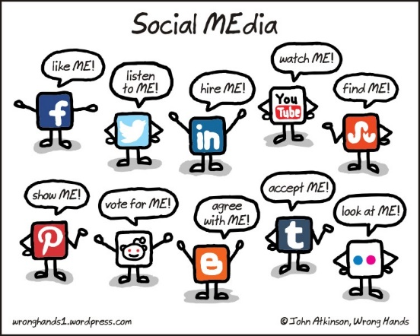
What is Social Media Listening?

Slide 5
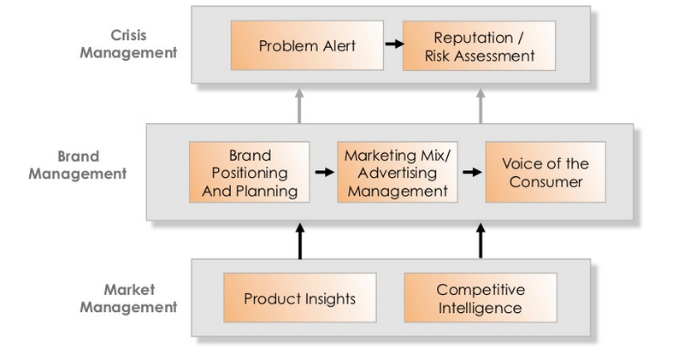
Why is social media listening important?
Source: sinotechgroup

Slide 6
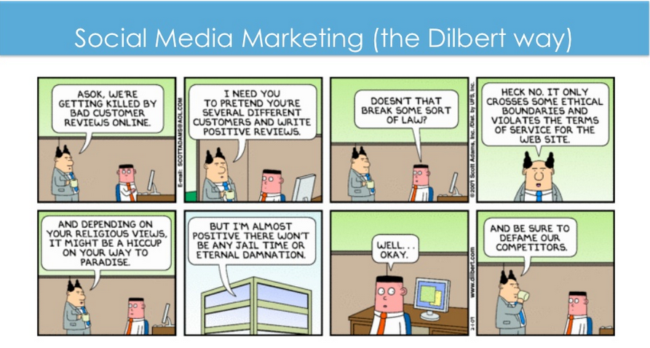
Case study Discussion

